Slide 1
Name
Title and Region
Date

Slide 2
Agenda
Networking Academy Impact and Reach
Demand for ICT Skills
How the Offline Solution is Implemented
Course Recommendations
Models of Practice (Case Studies)
Q&A
1
2
3
4
5
6

Slide 3
Networking Academy Delivers ICT Knowledge and Hands-on Practice
Notes:
Your learners need both the technology skills, and the career skills, or people skills, needed to succeed in the workplace. We make sure our courses and projects include development of both, including teamwork, communication, and problem-solving.
Our courses have always been available at traditional learning environments, like schools and colleges, but they are now also available in a wide range of organizations that offer education and training, such as prisons, community-based programs, libraries, and other government and NGO organizations.
Our research shows that leaners are better engaged with a variety of teaching tools, including instructor-led in the classroom, online independent learning, hands-on practice with equipment and/or simulations, and gaming.

Slide 4
Worldwide Leader in ICT Education and Training
9,600 Academy
Locations
257k
162k
170 Countries
68k
184k
190k
7 million Students Served
189k
20,000 Instructors
Cisco Networking Academy
1 million students currently enrolled globally
Preparing people for ICT careers since 1997
Notes:
You may already be aware of our commitment to -- and investment in -- education. We have nearly 20 years of experience partnering with education leaders and governments in developing and delivering high quality technology learning courses. Through this experience, we have become trusted advisors to technology education decision makers around the world.

Slide 5
National and Regional Impact Data
National
Regional
Academy Students Since Inception
Active Academy Students
Active Female Students
Active Institutions Partnering with Cisco
Active Academy Instructors
In-Kind Contribution Value Since Inception
##
##
##
##
##
##
##
##
##
##
##
##
Metrics as of ________
Notes:
IKCV amounts are available via Sandy Do in Corporate Affairs. For the US, see www.netacad.com/web/us/impact-profile

Slide 6
ICT Job Projections
ICT professionals are in increasing demand because of exponential growth in technology hardware and services
Networking is expected to be the second fastest growing ICT area, faster than the average growth for all occupations combined, as the world continues to invest in the Internet of Things (IoT)
Notes:
The Cisco Networking Academy program can help your organization prepare students get ready to compete for technology jobs in meaningful careers.

Slide 7
What Cisco Networking Academy Provides
Turnkey solution for training. Licensed free to nonprofit organizations.
All of this is available in a completely secure, offline learning environment at your facility
High quality courses and teaching tools
Secure, offline classroom setup
Discounts on equipment for hands-on practice
Instructor training, professional development
Offline teaching resources, grade books
Offline simulations, videos, textbooks, quizzes, assessments
Notes:
Cisco offers the courses license-free to not-for-profit institutions.
This program was created by educators, for educators. Behind the scenes are the unique team of Cisco experts, experienced educators working as instructor-authors, and industry and business partners enable us to stay abreast of the most current research in technology learning and employment-related needs.
Our design focus ensures that all lessons, media, hands-on labs, simulations and course assessments seamlessly work together to provide evidence of student progress towards achieving specified outcomes.
High quality courses and innovative learning tools prepare students for technology career paths, as well as industry-recognized certifications, which can be like a passport to the job market.

Slide 8
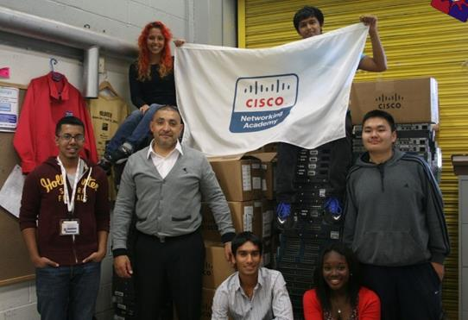
What Your Facility Would Provide
Instructor advocate, IT security manager, and classroom space.
Your IT security manager will identify what is required at your facility to maintain protocols
Your instructor and facility manager will locate and prepare classroom space (power outlets and work benches)
Cisco will implement the secure learning setup
You will need funds to purchase lab equipment (varies by course – often recently discontinued)
Student PCs
If no instructor is available, nearby programs already teaching our courses can help
Notes:
Instructor advocacy is a vital element in the success of the program.
In many cases, there is a nearby Cisco Academy Support Center (ASC), community college or other education program already teaching our courses that can provide additional support, for setup, instructor recruitment and training, and ongoing program development.

Slide 9
Our Course Recommendations and Certification Preparation
IT Essentials
CCNA 1
CCNA 2
A+ Certification
CCENT Certification (together)
Notes:
The A+ Certification comes from CompTIA. Cisco provides the other certifications, including CCNA, which is Cisco Certified Network Associate. Later, learners can go on to take more advanced courses and earn higher level Cisco certifications.

Slide 10
IT Essentials
Course Overview
Basic computer and career skills for entry-level IT jobs.
Students learn to set up and troubleshoot computers and software.
This course serves as a foundation for CCNA-level courses later.
Features
Target Audience: Secondary and 2-year college or vocational students
Prerequisites: None
Languages Available: Arabic, Chinese-S, Chinese-T, Croatian, English, French, German, Hebrew, Hungarian, Italian, Japanese, Polish, Portuguese-Brazilian, Romanian, Russian, Spanish, Turkish, Ukrainian
Course Delivery: Instructor-led
Estimated Time to Complete: 70 hours
Recommended Next Course: CCNA Routing & Switching
Course Components
14 chapters;
99 hands-on labs and 29 interactive activities
Cisco Packet Tracer simulations; videos
14 chapter exams, 1 checkpoint exam, 1 skills review exam, 1 practice final exam, 1 final exam, 1 skills-based assessment, and 2 practice exams for CompTIA A+ certification

Slide 11
CCNA Routing and Switching Courses (1-4)
Curriculum Overview
The 4 courses in the CCNA R&S course series help students develop a comprehensive understanding of how networks operate, from protocols and services to network management, with an emphasis on hands-on learning and essential career skills like problem solving and collaboration.
Career Preparation
Courses 1-2 align with the Cisco CCENT certification, and courses 3-4 align with the Cisco CCNA R&S certification. Students gain the skills needed to become network administrators, technicians, or managers.
Learning Components
4 courses: Introduction to Networks, Routing and Switching Essentials, Scaling Networks, Connecting Network
Hands-on labs and Cisco Packet Tracer network simulation activities
Videos and activities to reinforce learning
Quizzes and exams to measure learning outcomes
Features
Target Audience: Students interested in pursuing an IT-related career
Prerequisites: None, vocational students often take IT Essentials or equivalent knowledge prior to CCNA R&S
Languages Available: Arabic, Chinese-Simplified, English, French, Japanese, Portuguese-Brazilian, Russian, Spanish (courses 1 and 2 also available in German, Hungarian, and Turkish; course 1 available in Romanian)
Course Delivery: Instructor led
Estimated Time to Complete: 280 hours
Recommended Next Course: CCNA Security or CCNP R&S

Slide 12
CCNA R&S 1: Introduction to Networks
Course Overview
The first course in the Cisco CCNA Routing and Switching course series (1-4) teaches students about the architecture, structure, functions and components of computer networks.
Students achieve a basic understanding of how networks operate.
Benefits
By the end of the course, students will be able to build simple LANs, perform basic configurations for routers and switches, and implement IP
addressing schemes.
Features
Target Audience: Secondary, vocational students, 2-year and 4-year college aged students
Prerequisites: None
Languages available: Arabic, Chinese-Simplified and Traditional Croatian, English, French, German, Hungarian, Japanese, Portuguese-Brazilian, Polish, Romanian, Russian, Spanish, Turkish
Course Delivery: Instructor led
Estimated Time to Complete: 70 hours
Recommended Next Course: CCNA R&S Routing & Switching Essentials
Learning Components
11 chapters
33 hands-on labs and 1 hands-on skills assessment
Pre-test, 11 chapter quizzes, 2 sectional quizzes, 11 chapter exams, and 1 final exam
2 Cisco Packet Tracer Skills Based Assessments

Slide 13
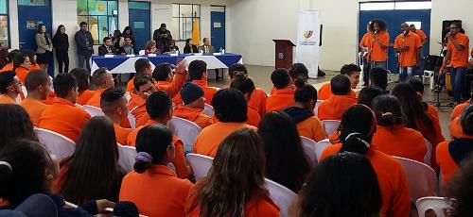
CCNA R&S 2: Routing and Switching Essentials
Course Overview
The second course in the CCNA Routing and Switching course series (1-4) describes the architecture, components, and operations of routers and switches in a small network.
Students learn how to configure a router and a switch for basic functionality.
Benefits
Students are ready to prepare for CCENT certification, skilled to apply for entry-level network technician jobs, and able to move on to advanced certifications.
Features
Target Audience: Secondary, vocational students, 2-year and 4-year college aged students
Prerequisites: CCNA R&S: Introduction to Networks
Languages available: Arabic, Chinese-Simplified and Traditional, English, French, German, Hungarian, Japanese, Portuguese-Brazilian, Polish, Russian, Spanish, Turkish
Course Delivery: Instructor-led
Estimated Time to Complete: 70 hours
Recommended Next Course: CCNA R&S Scaling Networks
Learning Components
9 chapters
19 hands-on labs and 2 hands-on skills assessment
Pre-test, 9 chapter quizzes, 2 sectional quizzes, 9 chapter exams, and 1 final exam
2 Cisco Packet Tracer Skills Based Assessments

Slide 14
Certification Alignment for NetAcad Courses
CERTIFICATIONS
CCENT
CCNA Routing and Switching
CCNA Security
CCNP
CompTIA A+
Network Professional
Network Specialist
CCNP
CCNA Security
Network Associate
Intro to Entreprene-
urship
CCNA Routing & Switching 1-2
CCNA Routing & Switching 3-4
Intro to Cyber- security
Network Technician
IT Essentials
IT Technician
JOB TITLES
Student Knowledge and Skills
Notes:
14

Slide 15
Steps to Teach ITE and CCNA 1 & 2
Start with a pilot class of 6-12 students
Identify criteria for student selection: 4-6 months prior to release, ready to learn, able to work in a group, etc.
Courses are 8 weeks long
IT Essentials (ITE) (16 hours week x 8 weeks = 128 hours)
CCNA-1 Intro To Networks (9 hours week x 8 weeks = 72 hours)
CCNA-2 R&S Essentials (9 hours week x 8 weeks = 72 hours)
Download course onto offline web server for local digital access
Supplement course with Cisco Press books
Course elements that can be accomplished offline:
Packet Tracer simulations
Videos and other learning activities
Chapter quizzes (students see immediate results and where to review)
Delivery of final exams

Slide 16
Cisco Course Delivery in Prisons and Correctional Facilities Around the World
EXAMPLES:
US-Colorado
US-Massachusetts
US-Minnesota
US-New Jersey
Brazil
Ecuador
Italy
Nigeria
United Kingdom
Notes:
We have developed a set of case studies (or success stories) around various active prison and correctional facility programs. See what’s going on in your region, or in a program similar to your own. I will share more details in the following slides.

Slide 17
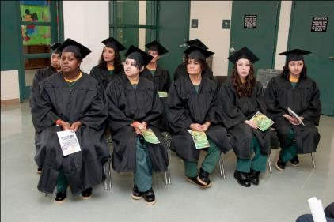
Program Success: USA Colorado
State Department of Corrections (CDOC)
CDOC was first U.S. prison to offer Networking Academy courses
Pilot program: 12 women inmates
11 completed the IT Essentials course and earned certifications
CDOC received a grant from the Department of Justice to fund 21 new classrooms in 7 more prisons
College credit provided to inmates
Now a model for other correctional facilities
“We fervently believed that we could change the lives of women in the prison system by encouraging them to learn in-demand skills in networking and IT.”
-Carl Wotowis, Assistant Director, CDOC Offenders Program
Notes:
Carl Wotowis, Assistant Director for the CDOC Offenders Program, reached out to Cisco, and was put in contact with academy instructors at nearby Arapahoe Community College and Pueblo Community College, already teaching NetAcad courses.
The first students who were invited to join the pilot program were 12 women inmates.
Eleven out of the 12 women completed their Cisco IT Essentials class and earned certifications.
The CDOC received a grant from the Second Chance Act Technology Careers Training Demonstration Projects for Incarcerated Adults and Juveniles, offered by the U.S. Department of Justice.
The grant allowed the CDOC to add 21 new classrooms in 7 additional prison facilities, as well as to expand the curricula to enable students to earn Cisco certifications that help to qualify for in-demand jobs.
The CDOC plans to bring over 500 men and women inmates through the computer training courses annually.
The CDOC’s Correctional Division of Education is setting up relationships with additional community colleges, and has launched a program to certify its own academy instructors.
The grant has also been a catalyst for a complete restructuring of CIS courses to better prepare inmates for success in Networking Academy classes.

Slide 18
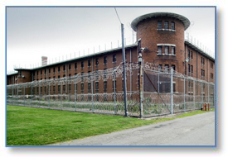
Program Success: USA Massachusetts
State Department of Corrections (DOC)
IT Essentials course for pre-release inmates taught by internal faculty (for A+ certification)
CCNA 1 & 2 computer networking courses (for CCENT cert)
3 instructors and 1 outreach coordinator for job placement
Won a Department of Justice 2nd Chance Grant (similar to Colorado DOC)
Partnered with Bunker Hill Community College to earn college credit for inmates
“Students in prison can be especially intimidated by these courses. They don’t think they’re smart enough to learn the material. When they master a concept, it’s like a light bulb goes off. It shows them they can learn anything.”
-Tom Romaniecki, instructor

Slide 19
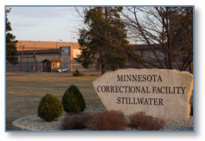
Program Success: USA Minnesota
State Correctional Facility and Minnesota Computers for Schools
Community-based organization (CBO) called Minnesota Computers for Schools wanted to bring training inside the state correctional facility at Stillwater
Selected the IT Essentials course due to its preparation for the A+ certification and an entry-level job after release
No internet connectivity allowed to teach the course
Stillwater staff member was trained to teach the course
“Learners take the ITE course in the classroom with the aid of textbooks, videos and the prison intranet. Quizzes are given and graded offline, and used by learners as study material for the final exam.”
-Instructor

Slide 20
Program Success: USA New Jersey
Ft. Dix Federal Prison and Camden Dream Center
Community-based organization (CBO) called the Camden Dream Center is building an end-to-end solution for prisoner re-entry
Focus on real world learning environment to help build ‘returning citizens’
Inmates are taken by bus to Camden Dream Center classroom (inmates access internet)
Courses: “Get Connected” (basic digital skills) and “Intro to IoT” (career exploration)
Inmates receive college credit from local community colleges
Later, they can continue taking courses in classrooms at halfway houses
Career mentoring and job search in partnership with the NJ Department of Labor
“If it can happen in Camden, it can happen anywhere.”
-Pastor Keith Davis, President and CEO of Camden Dream Center

Slide 21
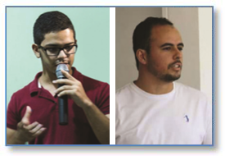
Program Success: BRAZIL
Federal Institute of Pernambuco, Caruaru
Program serves 14 to 18 year olds who are imprisoned on a part-time basis at the Casa da Juventude
Re-educating students in technology and career skills
Help overcome prejudices that socially vulnerable youth face in the job market
During pilot year, 3 cycles of students (80 students all together) enrolled in “Get Connected” and “Entrepreneurship” courses
Secretariat of Social Development of Children and Youth has requested expansion of the program to the state level, starting with Recife, the state capital
Best students are engaged with an employment agency to interview for jobs that match their profile
“Through this program, we can bring new knowledge and present a new labor market to the youth community of Caruaru. It’s a great Cisco initiative.”
-Manoel Neto, instructor

Slide 22
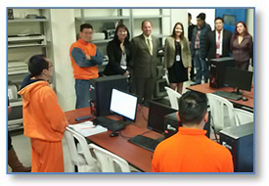
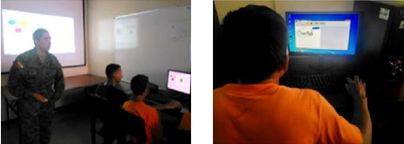
Program Success: ECUADOR Ministerio de Justicia
CRS Cotopaxi
Partnership with Universidad de las Fuerzas Armadas
Since 2016, 90 learners have participated
"Our intention is to help strengthen the technological skills of people deprived of their liberty in their rehabilitation processes. The results of efforts like these are positive, since it allows its participants to insert themselves properly in the world of work.“
-Diana Tamashiro, manager of Academic Sector and Corporate Social Responsibility at Cisco Systems,
for the Andean Region

Slide 23
Program Success: ITALY
Seconda Casa di Reclusione di Milano
Began in 2002
15 learners per course
Of 120 participants: 70% have been released, and of those, 80% have found work — none of them have returned to prison
Inmate released in 2011 has already started 2 companies of his own, claiming Cisco courses gave him the entrepreneurial skills needed
“I started 2 years ago with Cisco CCNA, and last year I passed the CCNA Security certification exam. Cisco Networking Academy courses really changed my perspective on life.”
-Inmate in furloughed program (leaves the prison each day to go to work)

Slide 24
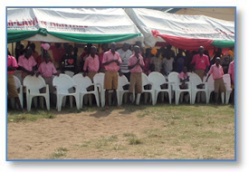
Program Success: NIGERIA Prisons Service
Orgun State, Borstal Detention Center
Remand correctional home rehabilitates prisoners between the ages of 16 and 23
Preparation for a new phase in life includes Cisco Networking Academy courses for delivery of ICT skills and entrepreneurship training
15 boys became 1st graduates of the IT Essentials course
Plan to extend the program to other Remand centers
“[NetAcad courses are] very educative and exciting. The boys enjoy the lessons and look forward to each day, which assisted us in preparing them for the future.”
- Mrs. Lawal I. G., head of the center

Slide 25
Program Success: UNITED KINGDOM
PICTA (Prison ICT Academy) Program
Her Majesty’s Prison and Probation Service: Public Sector
The pilot program was held in 8 prisons
In 2016, there were 19 active PICTAs teaching Cisco courses
To date, over 5,000 offenders have participated
Each learner participates at their own level and pace
Peer-to-peer mentoring strengthens teamwork and communication skills
Mentorship from Cisco employees
Now offering virtual access to courses for broader reach across prison system
“Having a feeling of achievement is just as important for these students as the ICT skills they’re acquiring. This isn’t about looking for the strongest candidates - we want everyone to be successful. If someone is struggling, it’s up to us to figure out how to give that person the support he needs.”
-PICTA instructor

